Slide 1
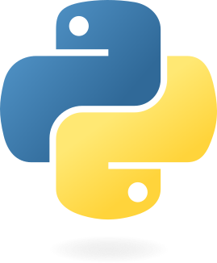
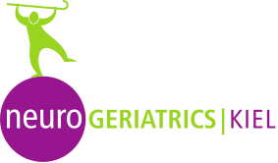
Python programming for the movement sciences
Jill Emmerzaal, Elodie Drew, Yunus Kaghembe, Bryce A Killen, Robbin Romijnders, Masoud Abedinifar, Julius Welzel, Clint Hansen, Philippe C. Dixon

Slide 2
Why learn Python
Notes:
This seminar is hardly enough for you to learn Python. Therefore, the aim is to give you a crude introduction to the language and give you the basic knowledge needed to get started.
The information in the introduction will be enough to understand basic python concepts that you will inspect in the tutorials. The accompanying Jupyter Notebook is there as a very succinct reference guide that you can use during the seminar.
My goal, in this first introduction, will be to help you understand the syntax of the python language and its environment. I will also strive to give you a basic understanding of the python documentation so you’ll be able to read and implement the different libraries.

Slide 3
Versatile with with broad applications
It’s free of charge
Has an easy, readable syntax
Extensive, powerful libraries
Interoperability with MATLAB

Slide 4
Guides and references
Ofiicial Python tutorial
NumPy for absolute beginners
Thonny--easy IDE for debugging
Udemy courses like 100 days of code or python for data science and machine learning bootcamp

